Slide 1


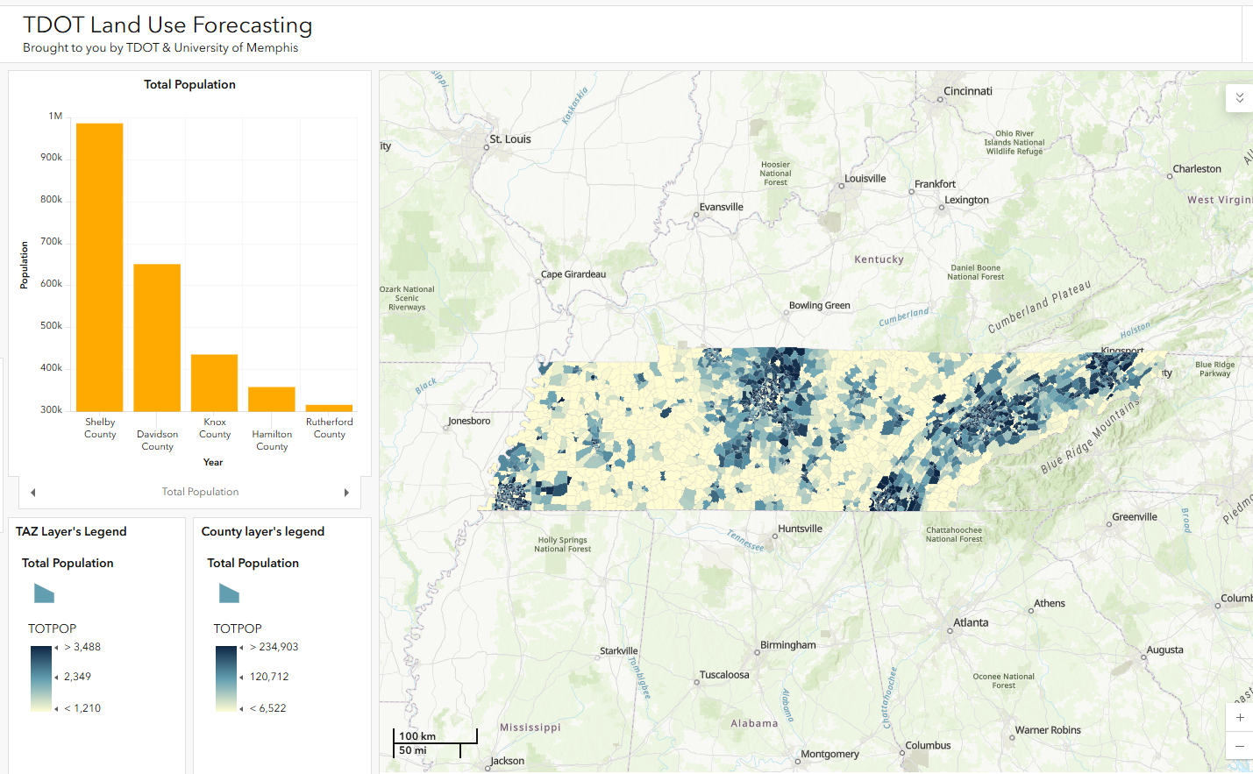
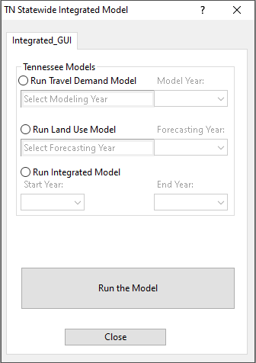
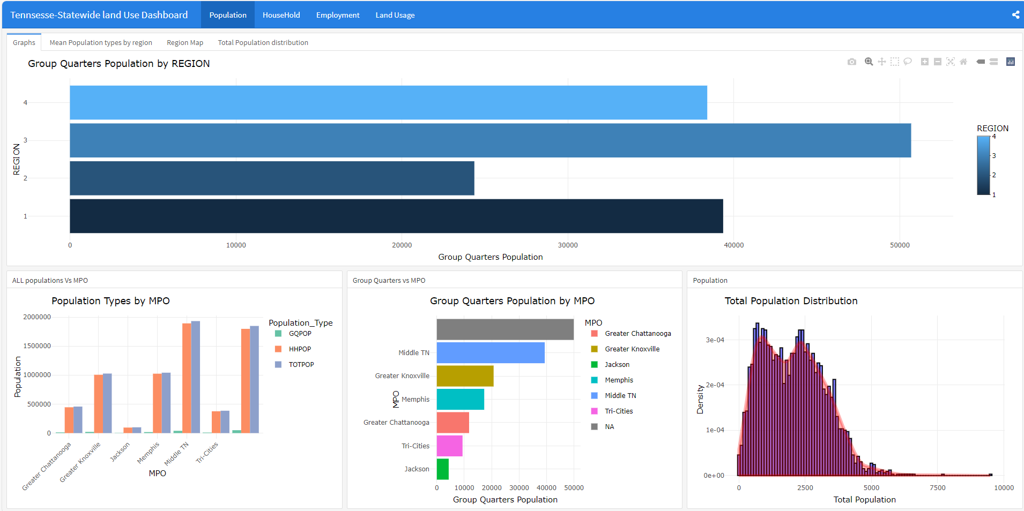
Tennessee Statewide Land Use Model Enhancements with Local Validation and Implementation
Dr. Sabya Mishra (PI)
By forecasting future land-use patterns, such as housing occupancy and land-use distributions, the model provides valuable insights for long-term planning and policy development. This integration bridges the gap between land use and transportation planning, enabling scenario analyses that account for planned zoning changes, infrastructure investments, and socio-economic shifts.
Objectives
Upgradation of state’s Large Scale- Land Use Model (LS-LUM) to ensure compatibility with Tennessee Statewide Travel Model (TSTMv4).
Development of an integrated model platform that allows LS-LUM and TSTMv4 to operate from a single source.
Tight coupling of TSTMv4 and LS-LUM, enabling users to perform sequential runs seamlessly.
Creation of an offline visualization tool capable of generating dashboards for every LS-LUM forecasting scenario.

